Slide 1

Banking Data Analysis: Key Insights
A comprehensive summary of the insights obtained about a marketing campaign from data analysis using Python.
Image source-pixabay

Slide 2
Agenda
1. Introduction
2. Data Cleaning
3. Demographic Analysis
4. Financial Behavior Analysis
5. Marketing Campaign Analysis
6. Analyzing trends
7. Correlation Analysis
8. Conclusion and Recommendations

Slide 3
1. Introduction
Objective- Term deposits are an important source of revenue for banks. Telephonic marketing campaigns are a primary method of pre-identifying potential customers. This data analysis serves to provide the same.
The data is imported from a csv file containing 19 columns and 45210 rows,i.e,data about 45210 clients is used for analyzing.
The preferred tool for the same purpose used is Python,an object oriented programming language that offers a wide range of libraries that make it suitable for data analysis.
Here,the libraries Pandas,MatPlotLib and Seaborn have been used to analyze data efficiently and make excellent visualizations.

Slide 4
2. Data Cleaning
Used the drop function for columns marital and marital_status with essentially same data for reduced redundancy.
Used the dropna function to drop rows with missing values in columns education and marital.
Converting binary values “yes” and “no” in the columns housing, loan (personal loan) and default (credit) to numerical binary values 0 and 1 using the replace function.
Above steps make handling data easier for further analysis.

Slide 5
3.Demographic Analysis

Slide 6
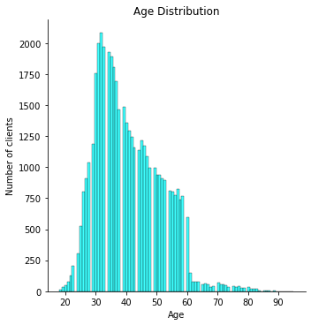
Age distribution amongst clients
The mean age of clients- 40.93
Maximum age of client=95
Minimum age of client=18
First quartile (25th percentile)=33
Second quartile(50th percentile)=39
Third quartile (75th percentile)=48
(all in years)
Histogram Bar of Age Distribution

Slide 7
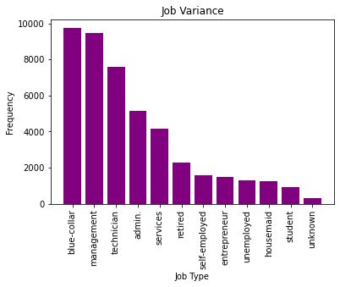
Job Type Variance
Blue collar industry (9732) comprises of most clients. It is followed by Management(9460) and Technician (7597).
Admin and Services have moderate number of clients, 5171 and 4154 respectively.
Rest categories-
retired- 2267
self-employed - 1579
entrepreneur - 1487
unemployed - 1303
housemaid - 1240
student - 938
unknown - 288
Bar Graph of Job Types among clients

Slide 8
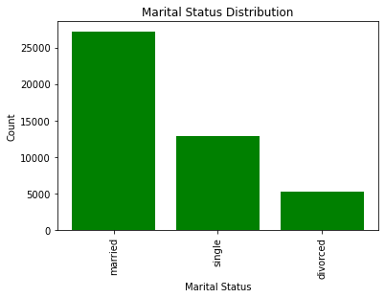
Marital Status of Clients
1.Married - 27216
2. Single - 12790
3. Divorced - 5207
Bar Graph for Marital Status Distribution

Slide 9
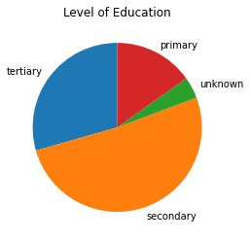
Education Level of Clients
secondary - 23201
tertiary - 13301
primary - 6851
unknown - 1857
Pie Chart for Level of Education

Slide 10
4. Financial Behavior Analysis

Slide 11
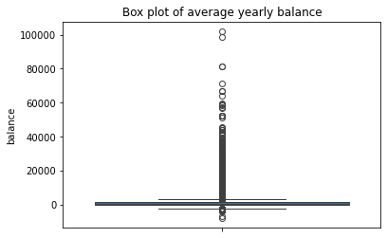
Clients’ Financial Status
Average yearly balance-
Mean=1362.33
Min= -8019
Max=102127
Credit in default-
815 people have credit in default whereas 44395 do not.
Loans(positive count)-
Housing loan- 25130
Personal loan- 7244
Box Plot

Slide 12
5. Marketing Campaign Analysis

Slide 13
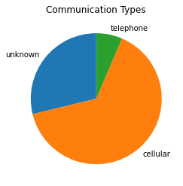
Communication Types used for Contact
cellular - 29288
unknown - 13020
Telephone- 2902

Slide 14
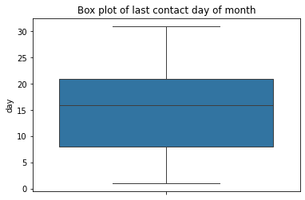
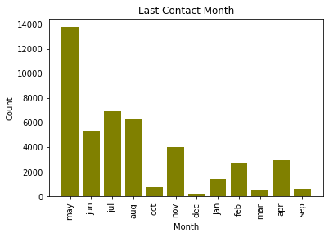
Contact Details (Both current and previous campaigns)
Mean date- 15th
However third quartile is 21st so most clients were contacted before 21st.

Slide 15
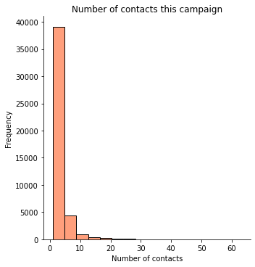
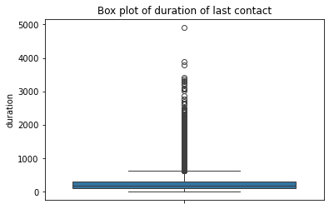
Cont>
mean 258.155342
75% 319.000000
max 4918.000000

Slide 16
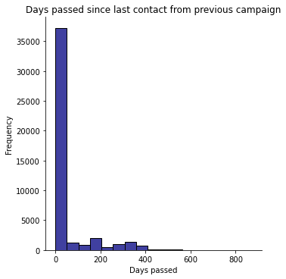
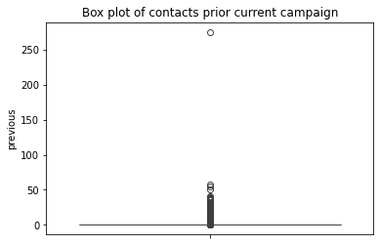
cont>
mean 40.187879
min -1.000000
75% -1.000000
max 871.000000
mean 0.580513
min 0.000000
75% 0.000000
max 275.000000

Slide 17
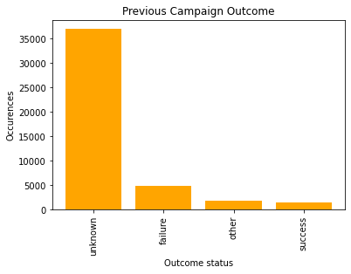
Previous Campaign Results
Important to analyze rates of success based on various factors.
Unknown- 36959
failure - 4900
Other- 1838
success - 1513

Slide 18
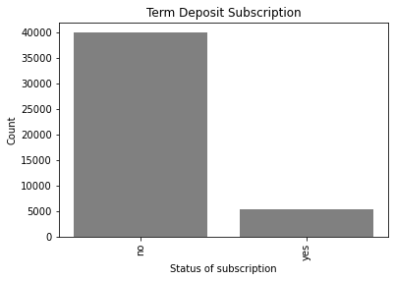
Term Deposit Analysis
Indicates whether the client has already subscribed to a term deposit or not.
no - 39917
yes - 5293

Slide 19
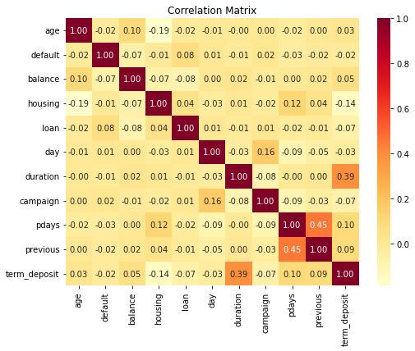
Correlation Heatmap
0 to 1 = positive correlation
-1 to 0 = negative correlation
0 = no correlation

Slide 20
6. Analysing Trends

Slide 21
Job Type Analysis
Age Distribution Observation
The majority of clients fall within the 30-40 age range, suggesting that the bank's primary customer base consists of middle-aged individuals.
This age group is likely to be in their peak earning years, which may influence their financial behavior and responsiveness to marketing campaign.
A large proportion of clients work in the 'blue-collar' and 'management' sectors, indicating a diverse customer base.
The prevalence of blue-collar jobs suggests a focus on stable, income-generating occupations, while the presence of management roles indicates a segment of higher-income clients.
Categories with lower count of clients such as student,household,retired are such due to low savings or income level to be able to invest.
Whereas entrepreneurs are naturally a small demographic and might be interested in other forms of investment such as trading.

Slide 22
Marital Status and Education Levels
A significant portion of clients are married, which may imply a preference for financial products tailored to families.
Term deposits are a safe way of investing money and hence correlate positively to marriage status.
Additionally, the majority have a 'secondary education,' suggesting a target demographic that values education but may not have pursued higher education.

Slide 23
Credit in default
Only a small percentage of clients have credit in default, indicating a generally low-risk customer base.
However, this segment could represent an opportunity for the bank to offer tailored financial products to help these clients manage their credit more effectively.
Average Yearly Balance
The median yearly balance suggests most clients maintain a moderate level of savings.
However, the presence of outliers with extremely high balances could indicate a small group of high-net-worth individuals who might benefit from premium banking services.

Slide 24
Loan Analysis
A significant number of clients have housing loans, indicating a strong demand for long-term financial products.
Personal loans are less common, suggesting that clients might prefer other forms of credit or may be more financially conservative.
Last Contact Analysis
Most client contacts occur toward the end of the month, possibly aligning with payroll periods. This timing might increase the likelihood of successful client engagement, as clients might be more financially stable during this time.
Also, most contacts were made in month of May as in many European countries, including Portugal, tax season typically ends around April when investors have a clearer picture of their financial status making it a strategic time for marketing.

Slide 25
7. Correlation Analysis

Slide 26
1. Positive Correlations:
Strongest Positive Correlation:The highest positive correlation is observed between pdays and previous (0.45), suggesting that clients contacted after a long period (high pdays) are likely to have had more previous contacts.
Duration and Term Deposit:The correlation between duration of the last contact and subscription to a term_deposit is 0.39. This indicates that longer contact durations are positively associated with a higher likelihood of clients subscribing to a term deposit.
Low Correlation with Age:Age has low correlations with other attributes, showing only a slight positive correlation with term_deposit (0.03) and balance (0.07). Age doesn’t strongly influence these factors.

Slide 27
2.Negative Correlations:
Housing loans and balance are negatively correlated (-0.07), indicating that clients with housing loans tend to have slightly lower average yearly balances.
Loan (personal loan) is negatively correlated with term_deposit (-0.07). meaning that clients with personal loans are slightly less likely to subscribe to a term deposit.
Campaign Contacts: The number of contacts during the campaign (campaign) shows low correlations with other factors. Notably, it has a low positive correlation with term_deposit (0.07), suggesting a slight tendency for more contacts to result in term deposit subscriptions.

Slide 28
8. Conclusion and Recommendations
1. Conclusion
The analysis provided a holistic understanding of client demographics, financial behaviors, and responses to marketing campaigns.
The findings highlight key client segments and behaviors that can be leveraged to optimize marketing efforts.
The insights gained can guide future strategies for better client engagement, improved financial product offerings, and overall campaign effectiveness.
2. Recommendations
Enhanced Client Segmentation: Use client data to create targeted segments for more personalized marketing.
Data-Driven Campaign Strategies: Design campaigns that address the specific needs and preferences of different client groups.
Continuous Monitoring and Adaptation: Regularly update strategies based on new data to stay aligned with evolving client behaviors and market conditions.

Slide 29

Thank You

